Slide 1
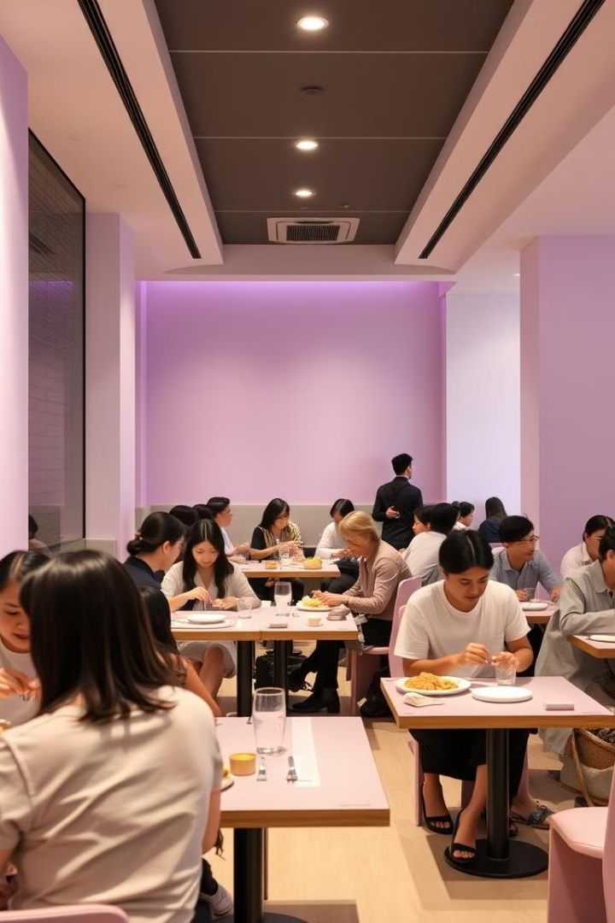

"Our web app streamlines restaurant operations with a dynamic menu, real-time cart updates, customer ratings, and integrated mapping for a seamless dining experience. It also offers hassle-free table booking and secure payment options, ensuring convenience for both customers and restaurant owners."

Slide 2
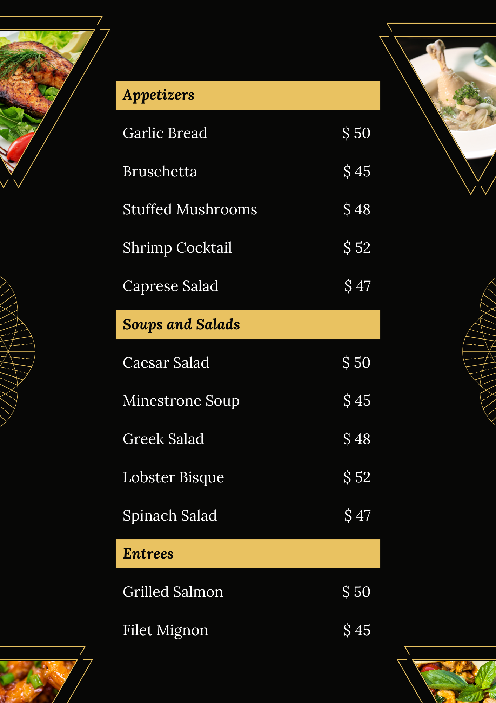
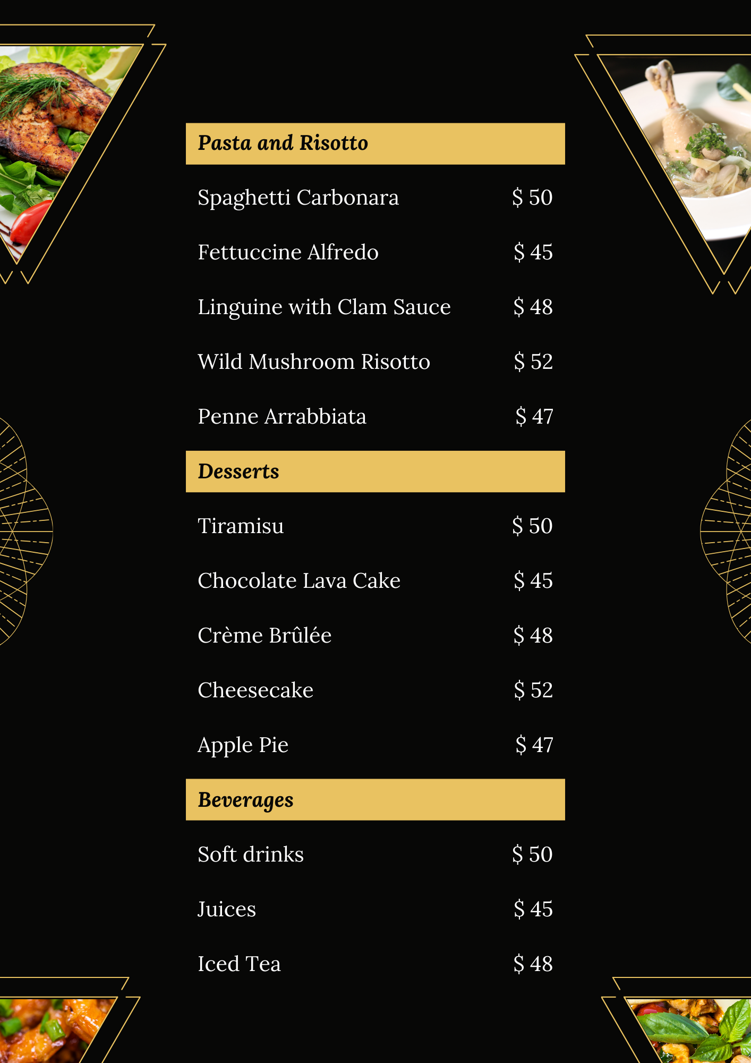
Dynamic Menu & Real-Time Cart
Interactive Menus
Real-Time Updates
Our application provides an interactive menu. Customers can easily browse and select items with ease.
The cart updates in real time as customers add or remove items. This is a seamless and efficient ordering experience.
W
e
l
c
o
m
e

Slide 3
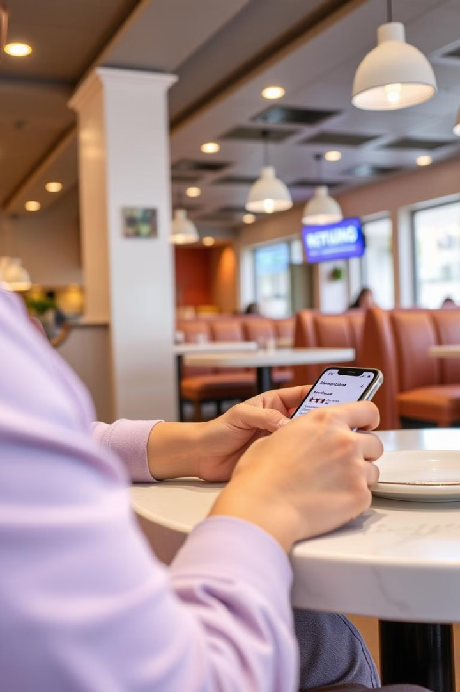
Customer Ratings and Reviews
1
Star Ratings
2
Detailed Reviews
Customers can rate menu items. This helps improve food quality.
They can also leave detailed reviews, sharing their experiences and providing valuable feedback.
3
Transparency
Positive ratings enhance the restaurant's reputation. Constructive criticism aids improvement.

Slide 4
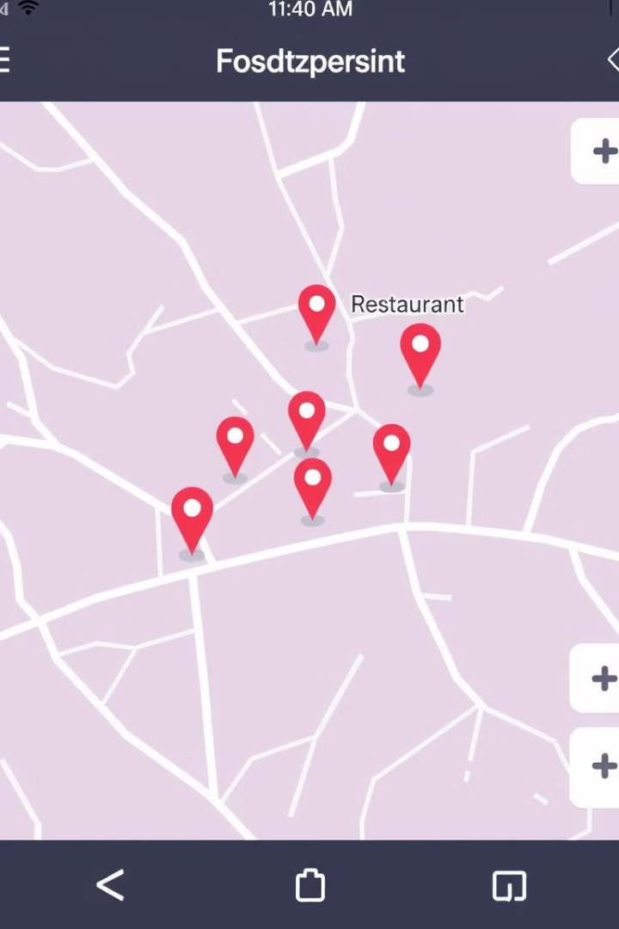

Integrated Location Mapping
Easy Discovery
Navigation
Customers can easily find restaurant locations nearby.
It provides turn-by-turn navigation, guiding them to the doorstep.

Slide 5




Owner Management Portal
Menu Control
Owners can effortlessly add, edit, or remove menu items.
Pricing Flexibility
They can also adjust pricing as needed, responding to market demands.
Specials
They can promote specials to boost sales.

Slide 6




Tech Stack Overview
1
Node.js
React
2
ML
4
MongoDB
3
Express.js
Our application is built using a robust and modern tech stack. This ensures scalability, reliability, and optimal performance. It includes React for the front end, Next.js for server-side rendering, Express.js for the backend API, and MongoDB for the database.

Slide 7
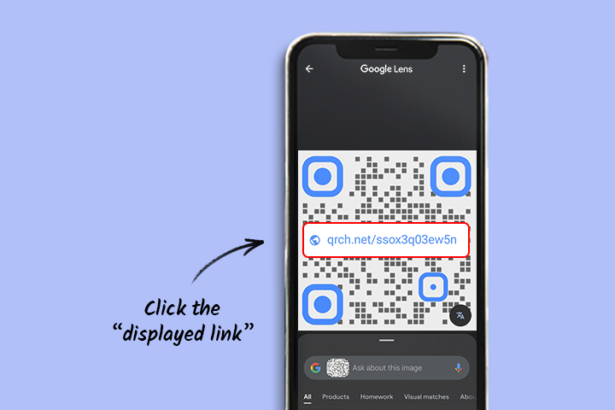
Streamlined Ordering with QR Codes
Scan to Order
Customers can scan a QR code using their smartphones to view the menu. They can start placing an order directly.
Reduced Wait Times
This reduces wait times and improves customer satisfaction. This is a smooth ordering process.

Slide 8
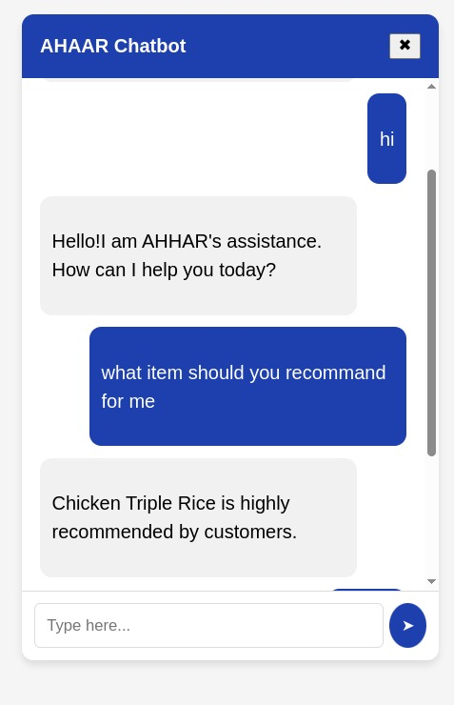
AI ASSISTANT
Introduction to AI-Assisted Dining
Personalized Dish Recommendations
Integration with Digital Menus and QR Codes
Enhancing customer satisfaction through smart recommendations.
Dynamic recommendations change based on time of day and season.
Personalized greetings and tailored suggestions right on the mobile device.

Slide 9
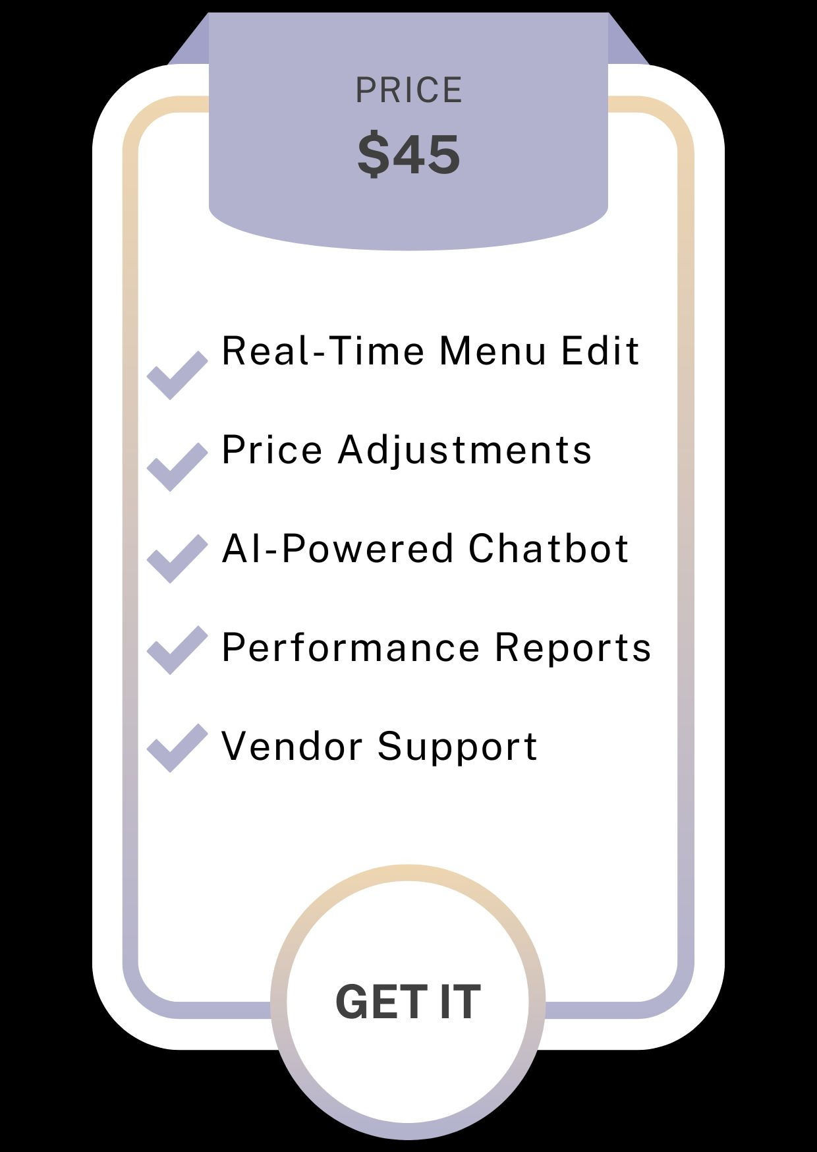
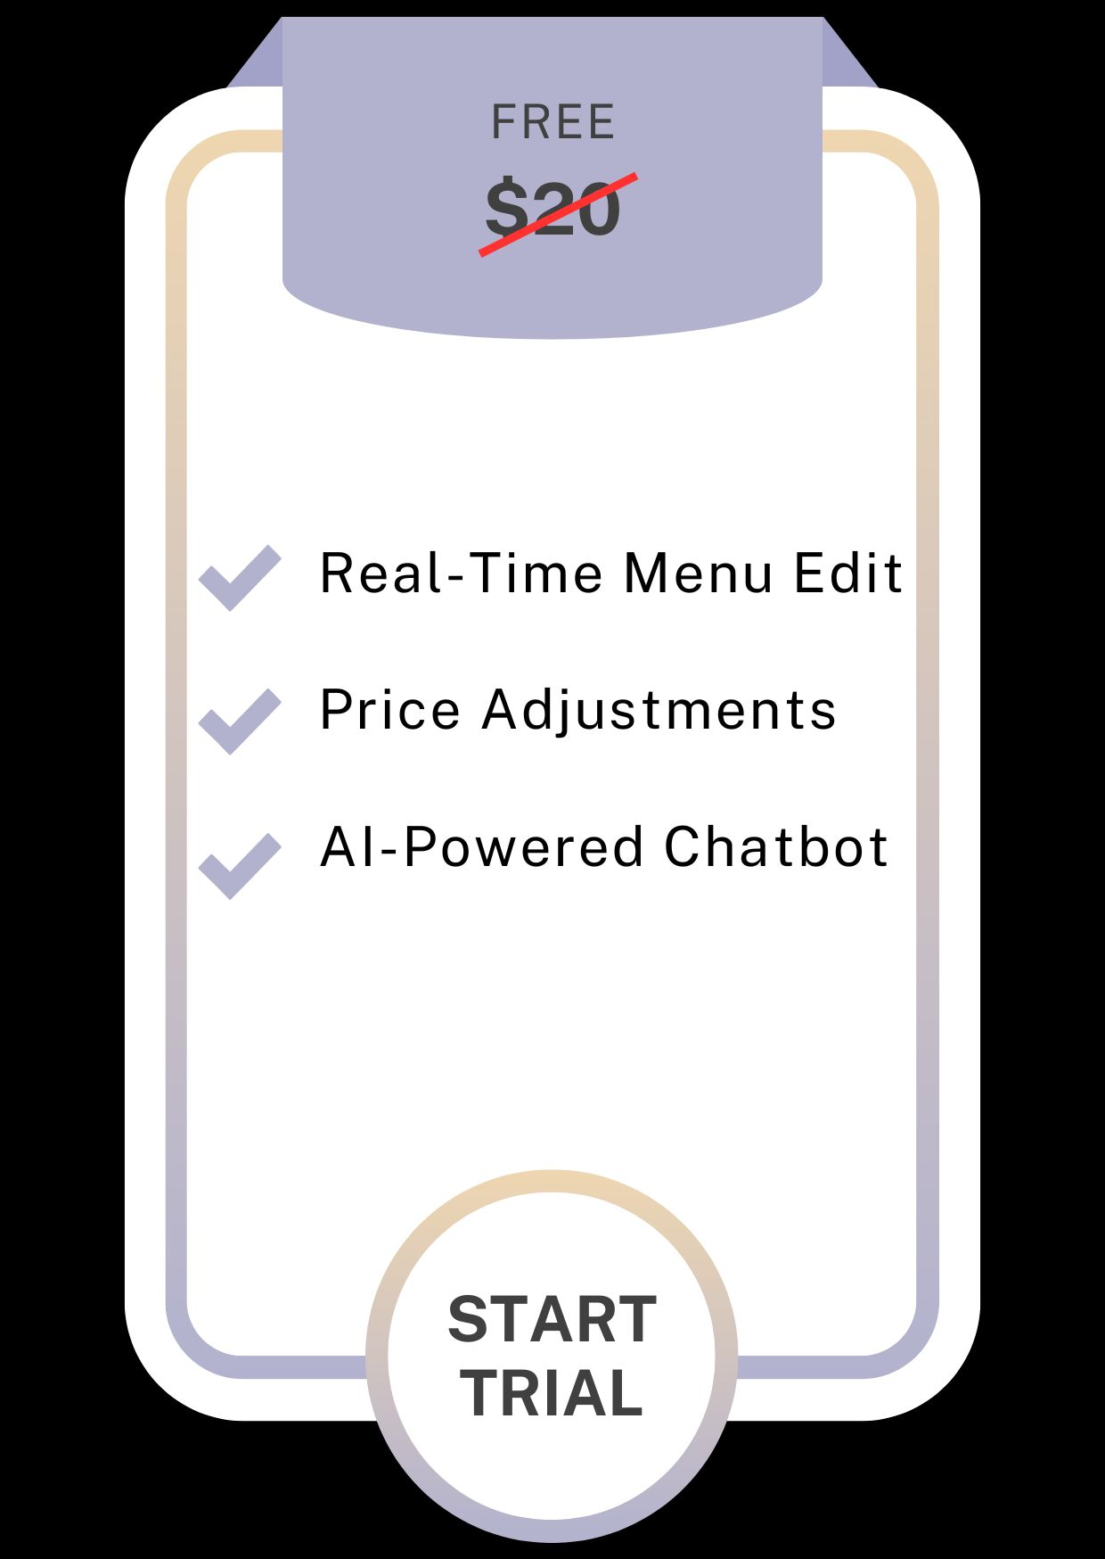
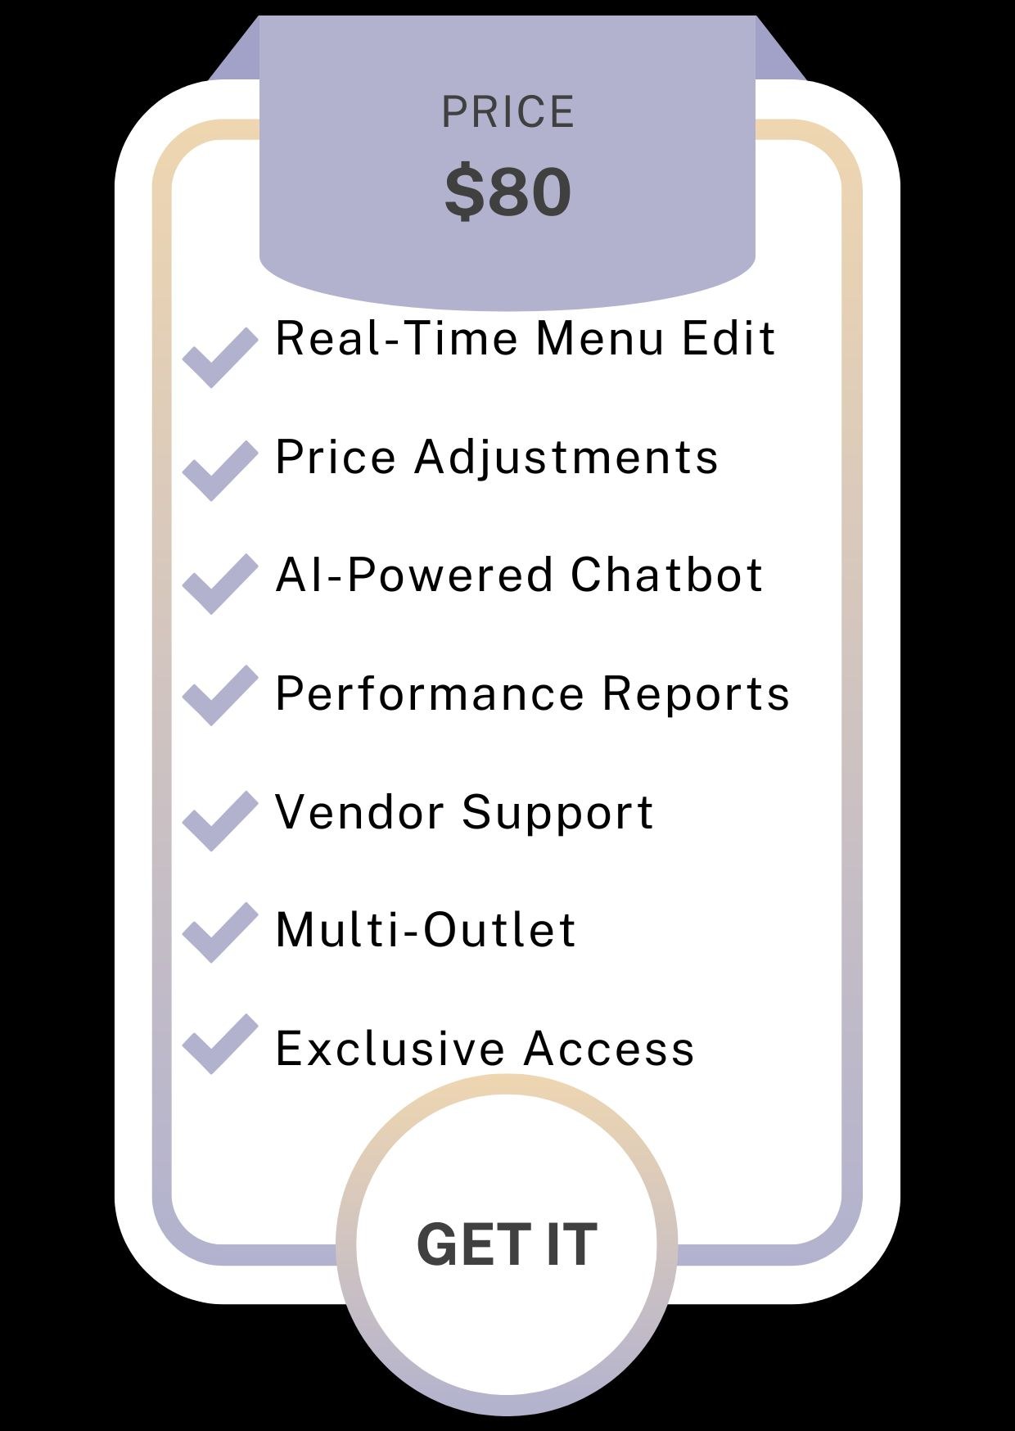
Revenue Model
Subscription Plans
Engagement Based Revenue

Slide 10

Key Takeaways & Next Steps
1
Enhanced Experience
2
Increased Efficiency
Our application enhances the dining experience. It makes everything more efficient.
It streamlines operations for restaurant owners, saving them time and money.
3
Proven Tech
We're using a modern tech stack that's fast and secure.

Slide 11
Unique Selling Proposition Analysis (USP)
Of Dynamic Menu Company
Market Analysis
Pickcel | Mvix | Yodeck | Intuiface | Ahaar
Product / Services
Customer Segments
Catering Feasibility
Dynamic Menu
Strengths
Digital signage, Menu boards | Displays, Interactive signage | Signage software, Media widgets | Interactive displays, Touch apps | Dynamic menus
Restaurants, Cafes, QSR chains | Offices, Schools | Small restaurants, Fast food, Retail | Exhibitions | Restaurants, Food courts
High | Medium | Medium to High | Medium | High
Real-time updates | Scheduled updates | Social media integration | User engagement | Flexible, Modern Menu
Custom templates, POS integration | Cloud management, Multi-location | Affordable, Easy setup | Customizable, Complex media support | Real-time sentiment tracking, AI-bot

Slide 12


